Slide 1
The Force of Art, Disobedience and Learning. Dennis Atkinson Goldsmiths University of London

Slide 2
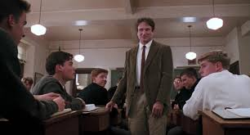

Slide 6
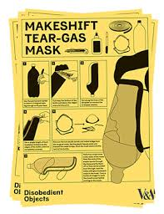

Slide 7
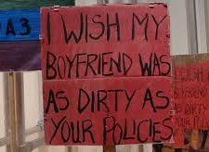
Have a care

Slide 8
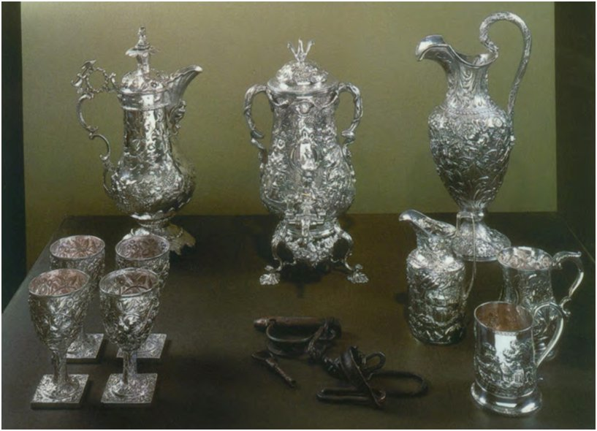

Slide 9
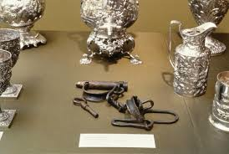

Slide 10
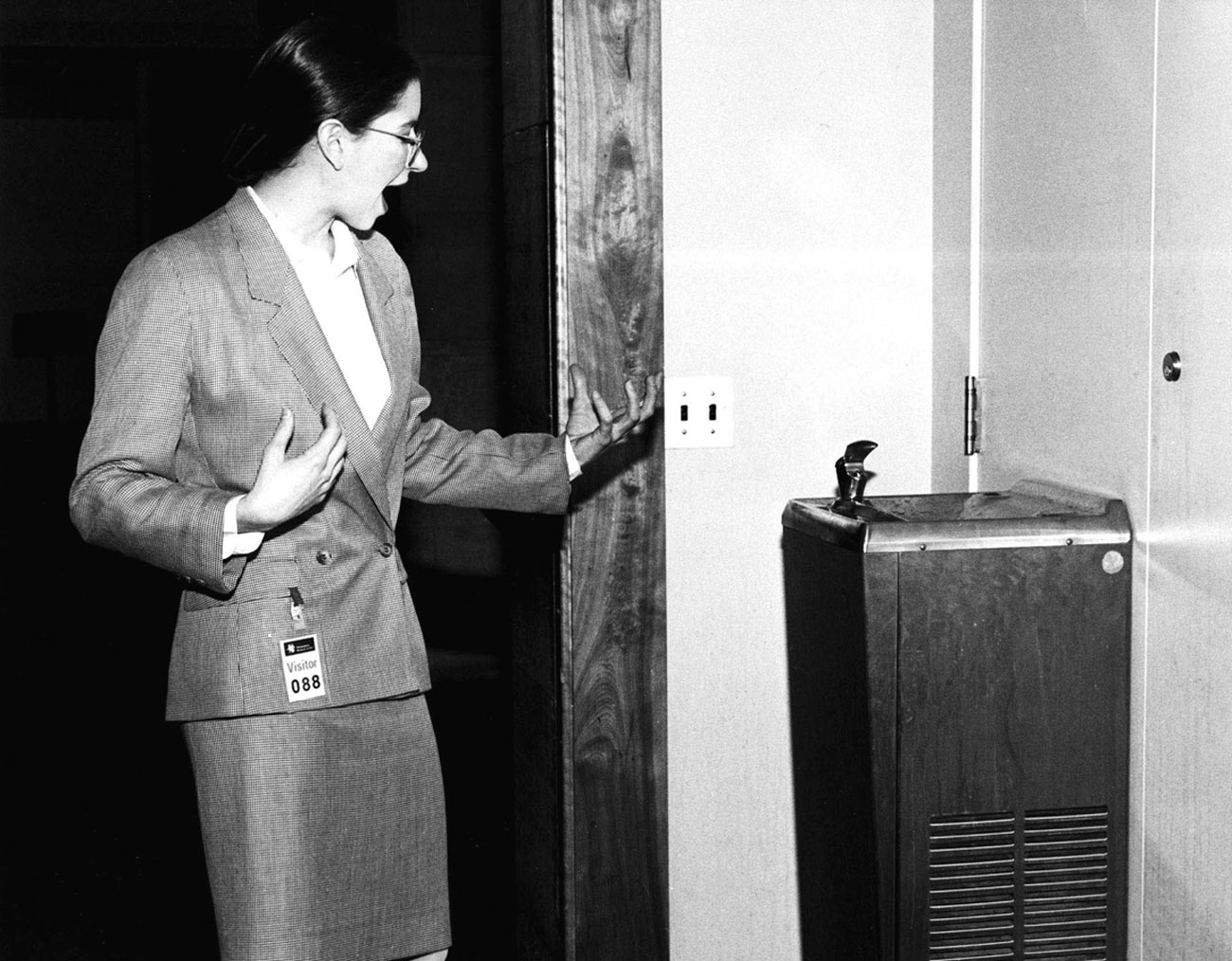

Slide 11
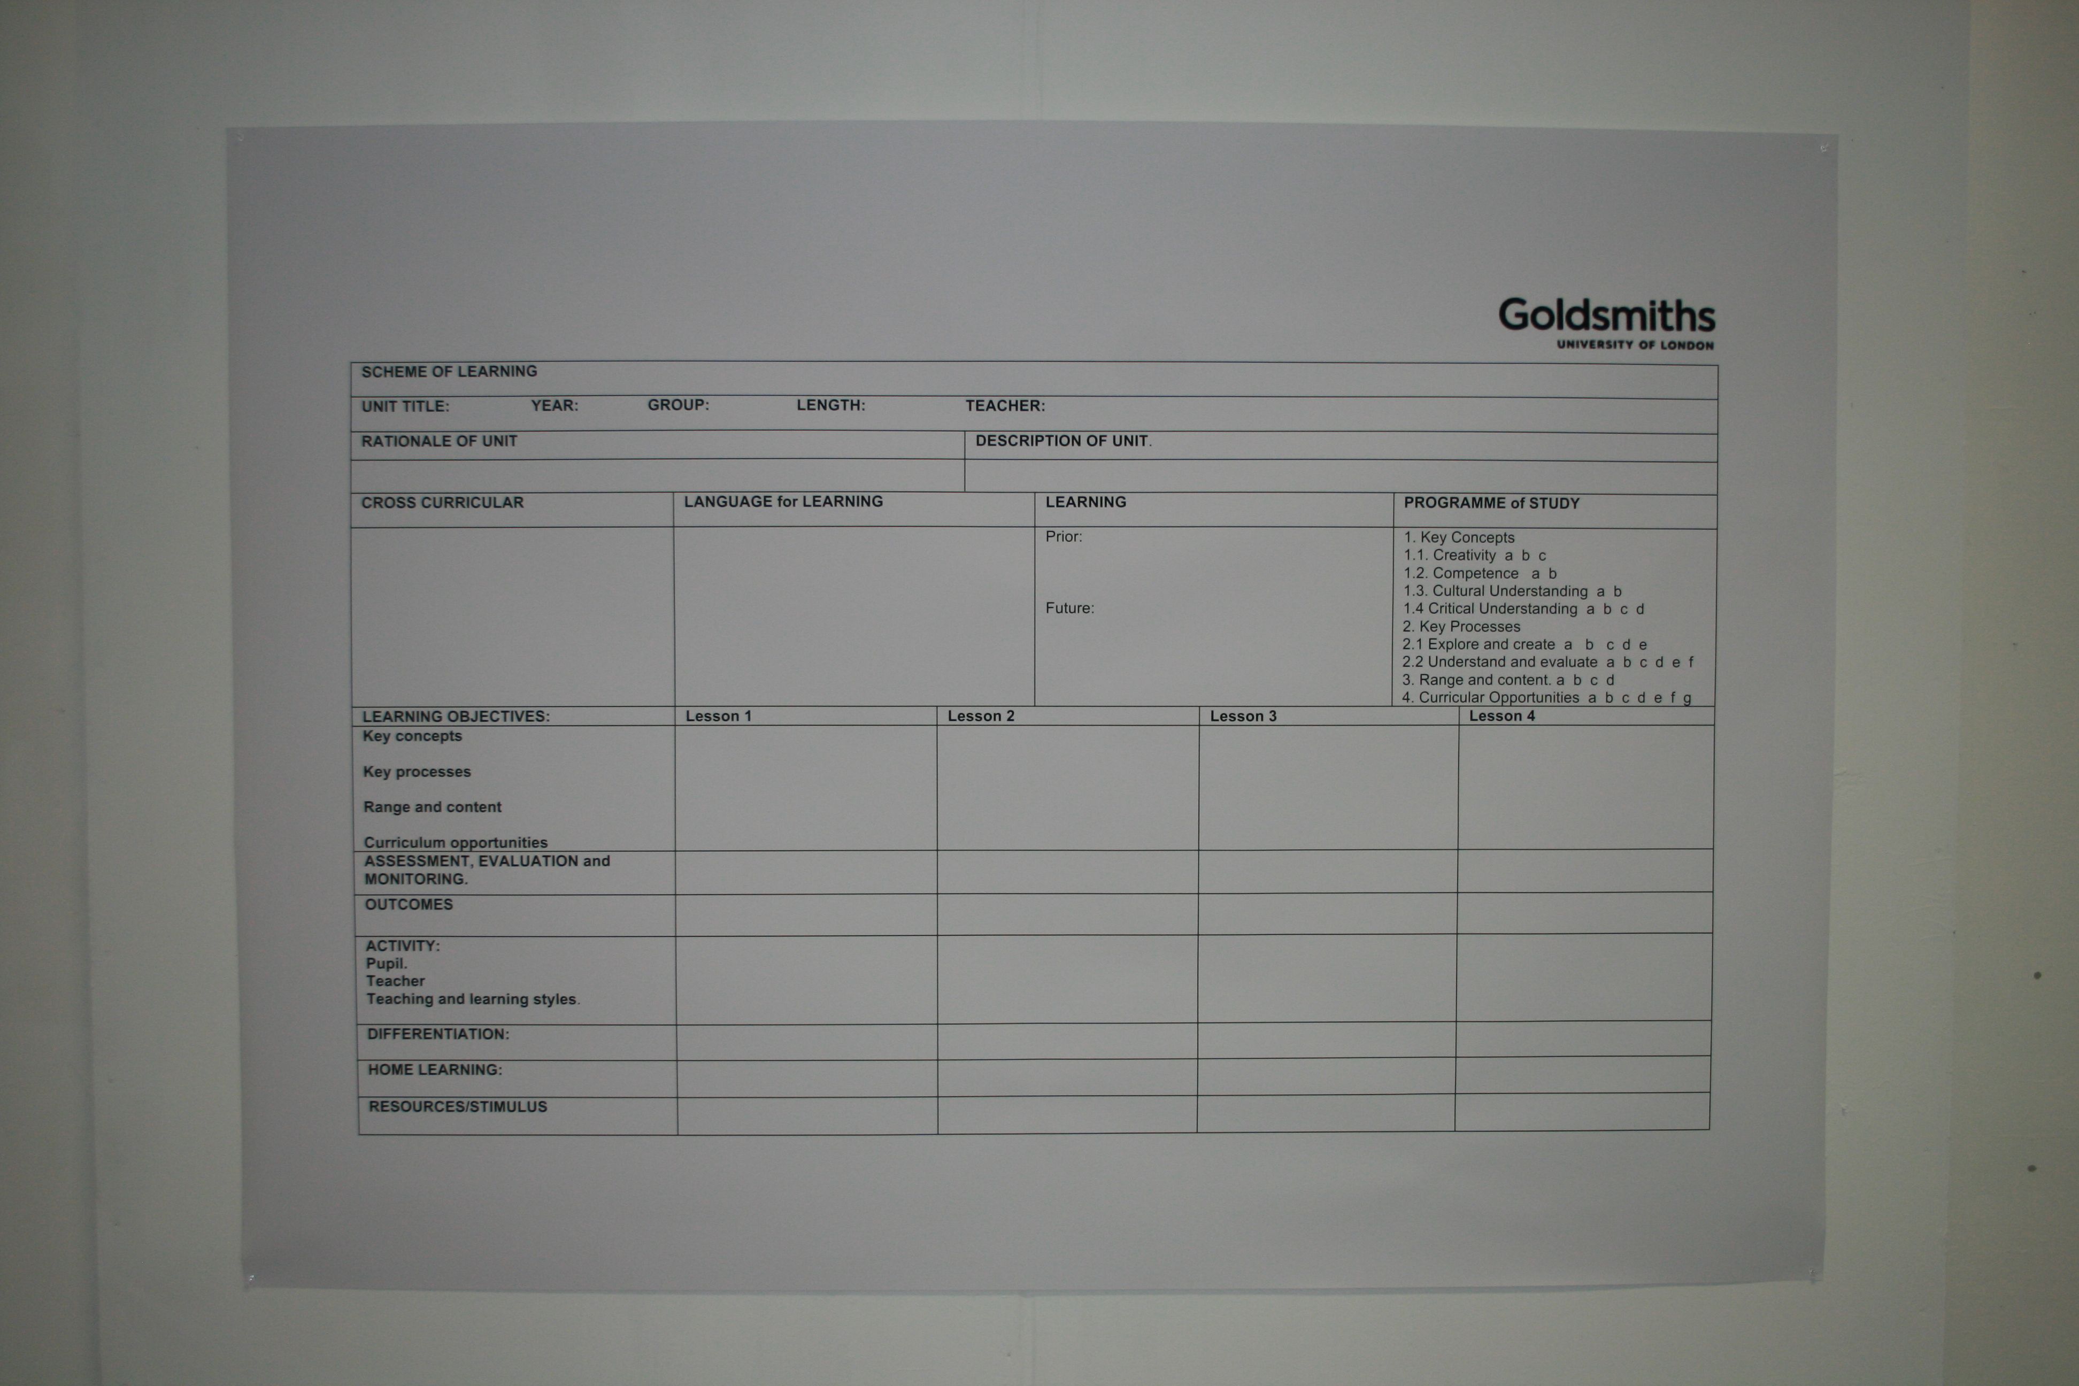

Slide 12
When beings come to be disclosed as “resources,” natural, mineral, human, or otherwise, it means that they are constituted in their very essence in terms of power, that is, as intrinsically disposed toward being manipulated and (re)produced and thus articulated as part of the general flow of power, or, in other words, as pre-programmed to take a form or a value that “makes” them what they are by virtue of “making” them participate in the intensification of power (Ziarek, Force of Art, p. 62,).

Slide 16
Without criteria

Slide 17
Kairos

Slide 18
Hylomorphism
Ecology
Relevance
Obligation

Slide 19
“Have a care, something here matters”
Alfred North Whitehead (Modes of Thought p.116)

Slide 20
Ritornello

Slide 21
